Slide 1
Guerrilla IT with Pharo
piotr@palacz.net

Slide 2
00
First Things First: Clarifications
Guerrilla in IT (be it with Pharo or without it) is just a metaphor.
It is not, among others:
An adaptation of Mao Zedong ideas on guerrilla tactics in practice
The enemy advances, we retreat; the enemy camps, we harass;
the enemy tires, we attack; the enemy retreats, we pursue.
An endorsement or an encouragement to incite or actually carry out any form of physical violence in the workplace.
And so on.
No animals were hurt when preparing this talk.
The Guerrilla in IT metaphor brings out some facets of the situation you are
likely to find yourself in when using Pharo in an Enterprise setting.
This setting has inherent challenges:
In some cases, mitigation could be attempted using Pharo, but it should not: there are better means for the mitigation.
In some other cases, it could be attempted fruitfully.
I am going to talk of both. Hence: Guerrilla IT with Pharo.

Slide 3
01
The Guerrilla Metaphor and IT
… As a description and as a strategy
02
Key Challenges and their Mitigations
… Featuring Guest Appearances by Requirements and Traceability
03
Enter Pharo into the Guerrilla
... Some examples and suggestions
04
Conclusions

Slide 4
01
More about Guerrilla
Guerrilla warfare is a type of asymmetric engagement:
competition between opponents of unequal strength.
Asymmetric engagement takes place between belligerents
Whose relative military power differs significantly, or
Whose strategy and/or tactics differ significantly.
These concepts have some elements of interest for us.

Slide 5
01
Interesting Pieces
Guerrilla as an indication of the status quo at hand, including:
Existing asymmetry in strength (personnel, resources, etc.)
Contrast in the impacts of failure on respective sides
Actual differences in strategy and tactics (as in e.g. in corporate/PM culture).
Guerrilla as an indication of a Strategy aiming to:
Magnify the impact of a small, mobile force on a larger, more
cumbersome one
Not simply to defeat an enemy, but (also) to win popular support

Slide 6
01
Guerrilla in IT
As a Strategy prescription:
Driving the solution rather than waiting for it to happen
Assuming broad SDLC responsibilities (from requirements to maintenance)
Being open to non-conventional solutions
Avoiding failure as a potentially lethal event
… etc.
As a Status Quo description:
Small or tiny teams
Relatively small budgets
Short timeframes
Dealing with defective requirements
Dealing with urgency, nervousness,…
… etc.

Slide 7
02
Key Challenges in Enterprise Setting
The key challenges in Enterprise-type projects center on:
Requirements
Traceability
[ IMO – YMMV]
On Requirements, because:
Reqs-related problems are common and wide-spread
Reqs are the first building block
Getting them wrong fundamentally dooms the effort
On Traceability, because:
It is either absent, misunderstood or mishandled
It ties the building blocks together, starting with Reqs
Getting it wrong sky-rockets the risk of failure

Slide 8
02
Meanings of Traceability
Narrow meaning (most common):Tracing testing artefacts (incl. tests and their
results) back to specific requirements, in order to prove that all requirements have been (a) implemented, and (b) positively tested.
Broad meaning (IEEE): the degree to which a relationship can be
established between two or more products of the development process, especially products having a predecessor-successor or master-
subordinate relationship to one another. [IEEE-610]
Abstract/academic idea: Linking together subsequent models using
well-defined model transformations
(e.g., from Requirements Model to Execution and Testing Models)

Slide 9
02
Traceability: Various Manifestations
Manifestations of Traceability in-the-large:
Absent (when contract language is deficient)
Lip service (when things go OK)
Antagonistic (when things start going bad)
Nuclear Fusion (when litigation is looming)
Backward-looking (almost always)
Manifestations of Traceability in-the-small:
Non-existent (the default)
Antagonistic and backward-looking (when things go sour)
Collaborative and forward-looking (when doing well)

Slide 10
02
Uses of Pharo in the Guerrilla
Can Pharo be used outside its usual place as a construction
and testing toolkit?
(2) Can it be used to mitigate the Requirements Predicament?
(3) Can it be used to help establishing a collaborative,
forward-looking traceability?
Yes!
Yes …
Yes …
How all the are even possible?
Yes

Slide 11
02
Possibilities
In the mainstream, the specification/design/construction/testing
overhead makes it unthinkable or at least impractical to use
its own tools to support the project outside of the construction proper.
This is not the case with Pharo:
Low cost/high speed of building assistive tooling makes
using Pharo to support the Guerrilla strategy
(a) conceivable and (b) feasible
Some types of that tooling (and associated simple practices introduced by it) produce disproportionally good returns …
Real-Life Examples?

Slide 12
03
Examples: Some Rules of Thumb
Go for simple/low-cost improvements that have high impact potential
Transforming representation of relevant data/information
Making accessing and/or modifying this information easier
Making generation of derived information painless, simple and quick
… and so on
Note: making this or that here is not in the context of the target app!
Avoid:
Things that cannot be fixed (e.g., an SDLC broken beyond repair)
Replicating functions that can be had at even lower cost (e.g., an OSS issue tracker)
Functions with low impact potential (which may still happen to be cool)
… and so on
Real-Life Examples?

Slide 13
03
Examples: Dealing with Requirements
… Real-Life Case
Transform the Reqs away from the typical inedible forms
Republish them (or their relevant parts) in a digestible form
(e.g. visualization) in an easy-to-access form (e.g., web site/portal)
Provide simple query/reporting capabilities
Show people that this is easier for them (and sometimes fun)
Excel, Word, and SharePoint
don’t cut it
Better traction with non-tech people
Better external visibility of the issues
More eyeballs -> better coverage -> better quality (eventually)
Opportunities:
To introduce structural corrections easily or painlessly
To divide-and-conquer -> faster turnover
To eliminate stop-and-go -> less friction

Slide 14
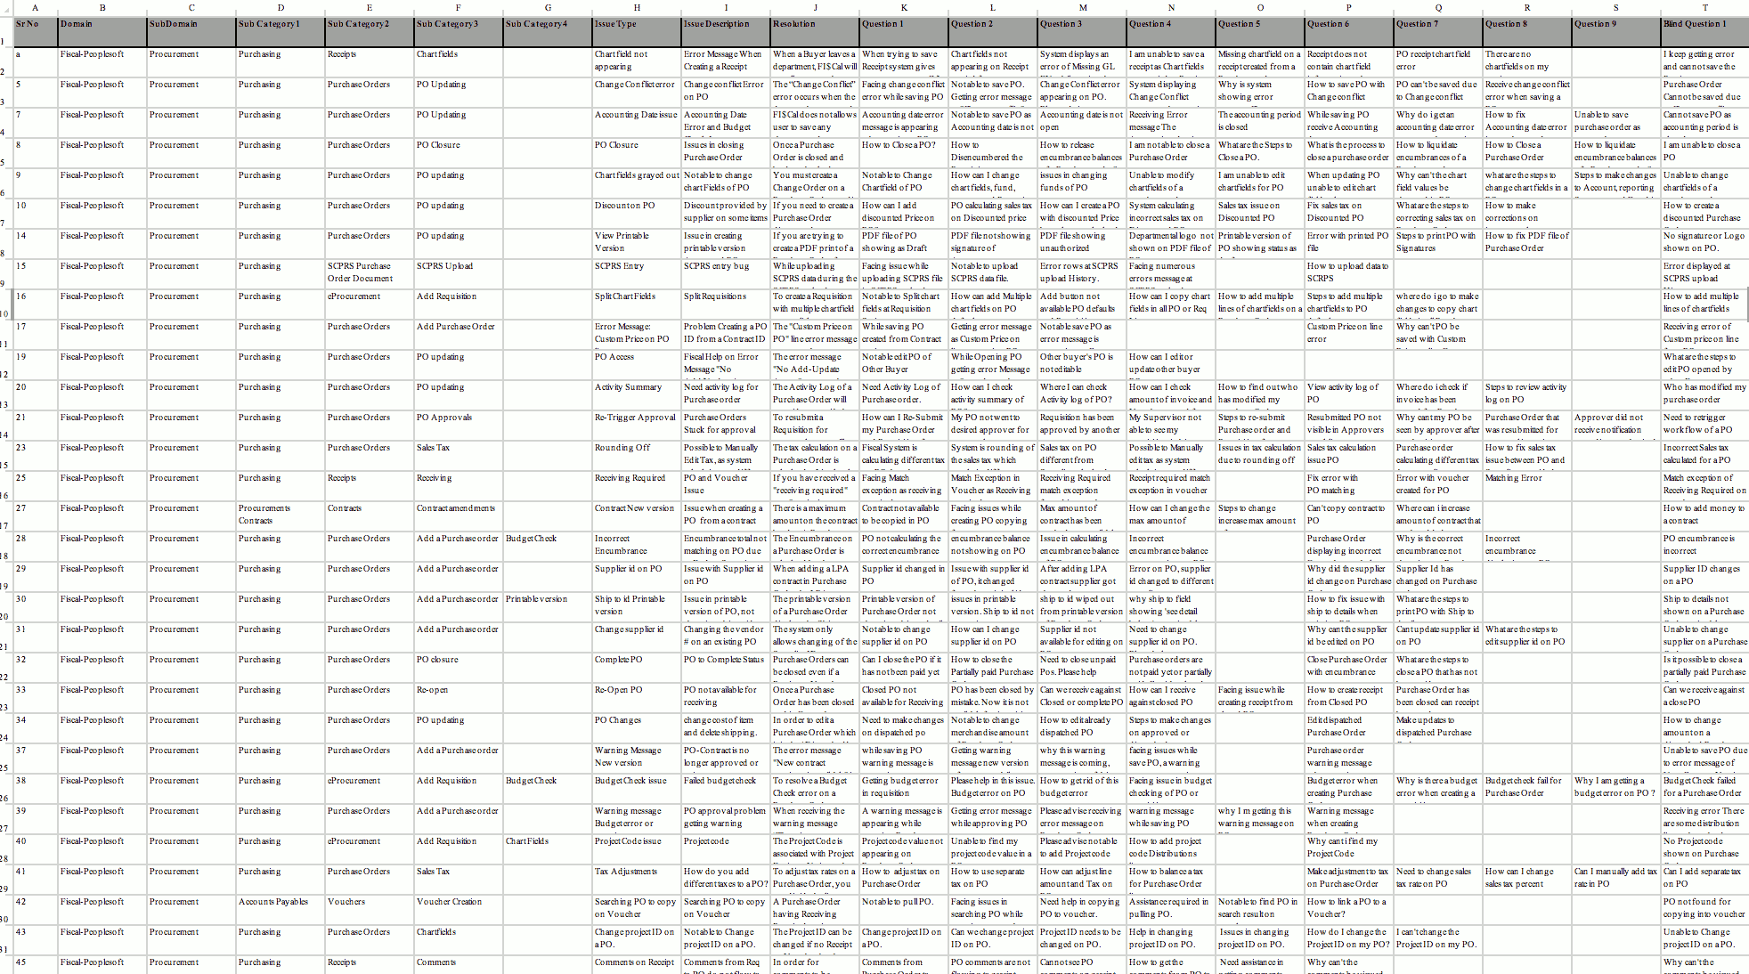
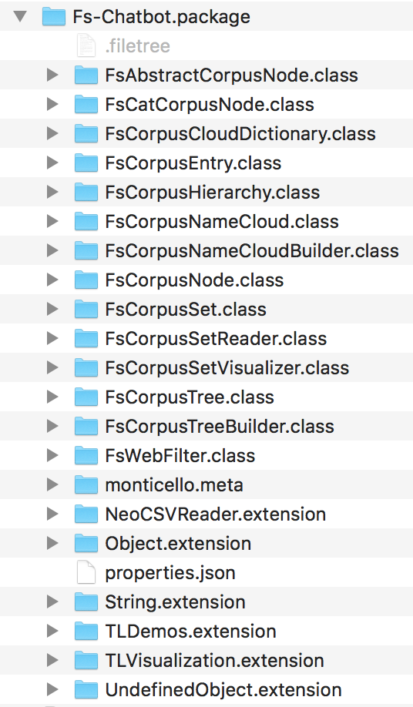
03
Example: Dealing with Requirements
… one of many ways
Pharo 6 + Cytoscape + Object Model
Proposed Corpus Structure – Interactive Exploration
Initial Excel Corpus and its Issues

Slide 15
03
Examples: Towards Better Traceability
… Real-Life Case
Identify requirement types that can be handled by
a DSL or the Interpreter pattern (typically, Business Rules are good candidate)
Reify the specs in a model
Provide for human-friendly self-description of that model
Provide self-descriptions for eyeballing (re-generation on
change) and simple collection of feedback
Modeling tools and Rule Engines
don’t quite cut it
Disambiguation of notoriously problematic areas (esp. Business Rules)
Early, pre-construction and pre-testing validation
of essential Reqs with potential design impacts
Opportunities:
To introduce improved precision and cohesion of the language
To divide-and-conquer the space
To introduce ownership and accountability

Slide 16
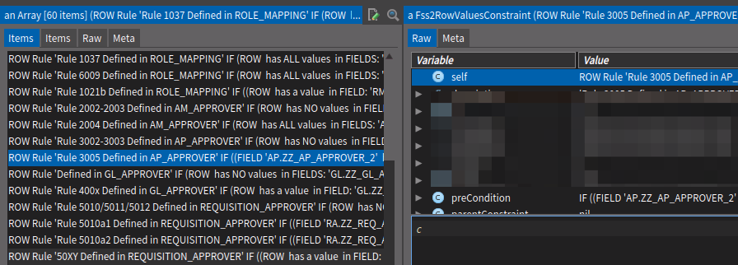
03
Towards Better Traceability
… Interpreter Pattern and Early Reqs Validation
Pharo 5/6 + GT + Seaside/Bootstrap + NeoCSV
ROW Rule 'Rule 3005 Defined in AP_APPROVER':
IF ( (FIELD 'AP.ZZ_AP_APPROVER_2' has value)
AND (FIELD 'AP.EMAILID' is none of (case-insensitive) { ... 300 entries ... }))
THEN ( FAIL with MESSAGE: 'Each AP Approver 2 must have approved AUD15 form’)
Self-textual renderings …
… of rule class instances
ROW Rule '50XY Defined in REQUISITION_APPROVER':
IF ((ROW has a value in FIELD: 'RA.ZZ_REQ_AD_HOC_APPR')
AND (ROW has at LEAST ONE value in FIELDS:
'RA.ZZ_REQ_APPROVER_1', 'RA.ZZ_REQ_APPROVER_2'))
THEN ( FAIL with MESSAGE: 'If Requisitions Ad Hoc Approver is identified,
then other Requisitions approver levels must not be identified')

Slide 17
04
Last Things Last: Conclusions
The Guerrilla Metaphor may:
Help you relate to real-life experiences when using Pharo in an Enterprise context
and what that entails
Help you consider what concrete Agile could be when the tire hits the road
Stimulate devising other useful ways of using Pharo across all phases of the SDLC
The key thought is that with Pharo:
Low cost/high speed of building assistive tooling makes using Pharo to support
the Guerrilla strategy (a) conceivable and (b) feasible
Some types of that tooling (and associated simple practices introduced by it) can produce disproportionally good returns.

Slide 18
Thank you
Comments, suggestions, feedback, etc.: please email piotr@palacz.net

