Slide 1
More XP-rience: What more have I learned about eXtreme Programming in the last 15 years? By Niall Ross, Cincom Systems @cincomsmalltalk (Twitter) #ESUG16

Slide 2
The core of eXtreme Programming
Test-driven development
Refactoring
Pair-programming
Tools
Psychology
(which I will now talk about in reverse order)

Slide 3
The first IT cartoon I ever saw

Slide 4
So we need some Pair-programming – how much?
Pair-program all the time? Maybe not.
There are two temperaments:
Introvert: gains energy when alone, expends it when with others
Extrovert: gains energy from others, loses it when alone
Some Smalltalkers are talkative, not shy of airing opinions – yet are introverts
Make some minimum obligatory:
Replace all one-one discussions / reports with pair-programming sessions
If you pair-program with someone regularly, you’ll know their progress
Thou shalt pair for at least X hours per week
Suggest a vague length - a “we can end after” time
@cincomsmalltalk #esug16

Slide 5
Unequal and equal pairings
Sharing knowledge on a common task:
Domain expert with code expert
Experts in two required frameworks
Leader and follower:
Old-timer with newbie
Handover
Equal in skill, not in temperament:
Innovator versus completer
Clean-code versus get-it-working
Cloners, overriders and respecters
@cincomsmalltalk #esug16

Slide 6
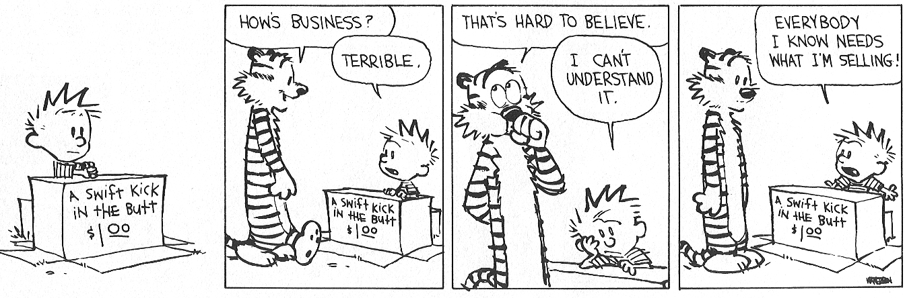
Persuading the paired programmer to try your idea
“The combative engagement of creative intellects“
“The creative engagement of combative intellects“
Which will it be this time?
@cincomsmalltalk #esug16

Slide 7
When and why should one not pair-program
Any good reasons
Trivial reasons to delay or halt-resume
Refamiliarise with area
Clean-up
Design
Think and talk at the same time?
Avoid tunnel vision
“Blessed is the man who, having nothing to say, refrains from giving long-winded evidence of the fact.”
And finally, the worst reason of all
“When pairing, if I’m driving, I can’t be lazy.”
@cincomsmalltalk #esug16

Slide 8
Screen-sharing Tools for Pair-programming
And I thought I had learned little in fifteen years !
15 years ago, my team of 6 pair/multi-programmed with:
NetMeeting (Windows only, otherwise good: instant, set-up, easy mouse handover)
Headsets with boom microphones (clean sound quality) on conference calls (robust)
Today, in mostly-smaller teams, I pair-program with:
Basic Skype (no mouse or keyboard sharing) or Lyncs (no Mac as yet)
WebEx or TeamViewer (mouse-sharing not quite as easy as NetMeeting)
VNC (good, needs both client and server to pair, takes a bit of set-up)
and (often)
microphones embedded in the computer, carried over (less reliable) Skype
@cincomsmalltalk #esug16

Slide 9
Refactoring
Anything I do more of than I did 15 years ago?
Inline method
Convert calling chain into one method
Re-break it into methods chunking the behaviour differently
Add/remove parameter
Usually adding – behaviour migrates upward, state downward
Removing - behaviour migrates from parameter to state
Convert to Sibling
Great when you (rarely) need it
I’m sure the UI could be clearer
@cincomsmalltalk #esug16

Slide 10
Test-Driven Development
“Solve the problem to understand the problem” - makes writing initial tests hard as well
Early tests
Script in a test, not a workspace
Agree a test, not words
A test framework is empowering
when you add fresh tests, think: refactor test framework?
Tests you don’t work on right away?
nagging tests
aspirational tests
@cincomsmalltalk #esug16

Slide 11
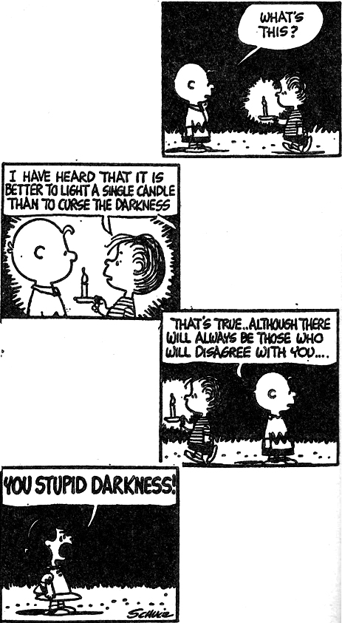
Programming is not that easy
Humans are not that good at it
Smalltalk pushes the boundary of what you can do
Fight the problem, not the language
eXtreme Programming does the same
Make it run (wrong!)
Make it right (less wrong!)
Make it fast (er)
I get by with a little help from my friends
pair-program – as much as you can (bear)
@cincomsmalltalk #esug16

Slide 12
Thank You!
Suzanne Fortman Program Director / Engineering Manager sfortman@cincom.com @SuzCST (Twitter)
Arden Thomas Product Manager athomas@cincom.com @ArdenTCST (Twitter)
Niall Ross Senior Research Engineer nross@cincom.com @cincomsmalltalk (Twitter)
@cincomsmalltalk #esug16

